Slide 1
Single Cell Genomics
Course Director
Yoav Gilad
Human Genetics department
CLSC room 325C
Phone: 773-702-8507
Email: gilad@uchicago.edu
Teaching Assistant
Katie Rhodes: klrhodes@uchicago.edu
Lecturer
Sebastian Pott: spott@uchicago.edu

Slide 2
Outline
Examples of cell-to-cell variation
Motivation for single cell RNA-seq and case studies
Single cell epigenomic approaches
Single cell DNA-sequencing
‘Multi-omics’

Slide 3
Random X-inactivation leads genetically identical cells to differ
Symmons and Raj, Molecular Cell, 2016

Slide 4
Different components of expression variation can be observed in individual cells
Elowitz et al., Science, 2002

Slide 5
Intrinsic vs. extrinsic components of noise
Elowitz et al., Science, 2002

Slide 6
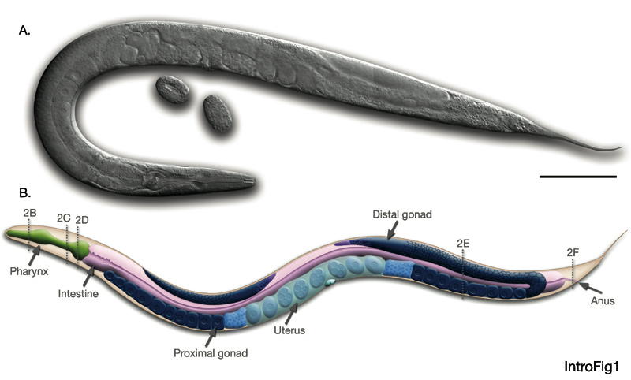
Single cell variation underlies incomplete penetrance in C. elegans
http://www.wormatlas.org
Raj et al., Nature, 2010

Slide 7
Single cell variation underlies incomplete penetrance
wt
Skn-1 mutant
Raj et al., Nature, 2010

Slide 8
end-1 level above threshold is associated with elt-2 expression
Raj et al., Nature, 2010

Slide 9
What are the problems addressed with single cell genomics methods?
Transcript level differences between cells
Many different methods
Epigenomic variation
DNA methylation
Chromatin accessibility
Genome organization
Transcription factors
DNA sequence differences (CNVs, SNV)

Slide 10
Applications of single cell RNA-seq

Slide 11
True relationships between transcripts might not be apparent from bulk samples
C. Trapnell, Genome Research, 2015

Slide 12
Deconvolving heterogeneous cellular mixtures
Liu and Trapnell, F1000, 2016

Slide 13
Identification of developmental trajectories
Tanay and Regev, Nature, 2016
C. Trapnell, Genome Research, 2015
Liu and Trapnell, F1000, 2016

Slide 14
Dissecting transcriptional mechanisms
C. Trapnell, Genome Research, 2015

Slide 15
Correlation between genes within cells allows for the inference of gene regulatory networks

Slide 16
How to isolate single cells?

Slide 17
Single cell RNA sequencing
Shalek et al., Nature, 2013

Slide 18
Alternative splicing events in single cells
Shalek et al., Nature, 2013

Slide 19
Microfluidics – e.g. C1 Fluidigm platform
Picelli et al., RNA Biology, 2016

Slide 20
Design considerations for scRNA-seq experiments
Tung, Blischak, Hsiao et al, Scientific Reports, 2016

Slide 21
Spike-Ins are important to assess technical variability – but not without problems
Tung, Blischak, Hsiao et al, Scientific Reports, 2016

Slide 22
Design of single cell RNA-seq experiments needs to take batch effects into account.
Tung, Blischak, Hsiao et al, Scientific Reports, 2016

Slide 23
Drop-seq can measure RNA-seq profiles in thousands of cells in parallel
Macosko et al., Cell, 2015

Slide 24
Construction of beads coated with uniquely barcoded oligos
Macosko et al., Cell, 2015

Slide 25
Drop-seq sequencing read processing scheme
Macosko et al., Cell, 2015

Slide 26
Drop-seq captures mRNA from individual cells
Macosko et al., Cell, 2015

Slide 27
Single cell characterization of the mouse retina..
Macosko et al., Cell, 2015

Slide 28
..led to discovery of novel cellular subpopulations
Macosko et al., Cell, 2015

Slide 29
Combining RNA-seq with marker gene information for spatial mapping
Satija, Nature Biotechnology, 2015

Slide 30
Summary single cell RNA-seq
scRNA-seq captures the mRNA content of a single cell
Very noisy compared to
scRNA-seq can be used for an unbiased and marker-free characterization of the cellular composition of complex tissues
Measure cell-to-cell variability of transcript levels
UMIs and spike-ins are useful and often required

Slide 31
Mapping regulatory interactions using single cell genomics

Slide 32
Using perturbation to infer regulatory networks
Tanay and Regev, Nature, 2016

Slide 33
Perturb-seq
Dixit et al., Cell, 2016

Slide 34
Perturb-seq
Dixit et al., Cell, 2016

Slide 35
Single cell ‘epi’genomics

Slide 36
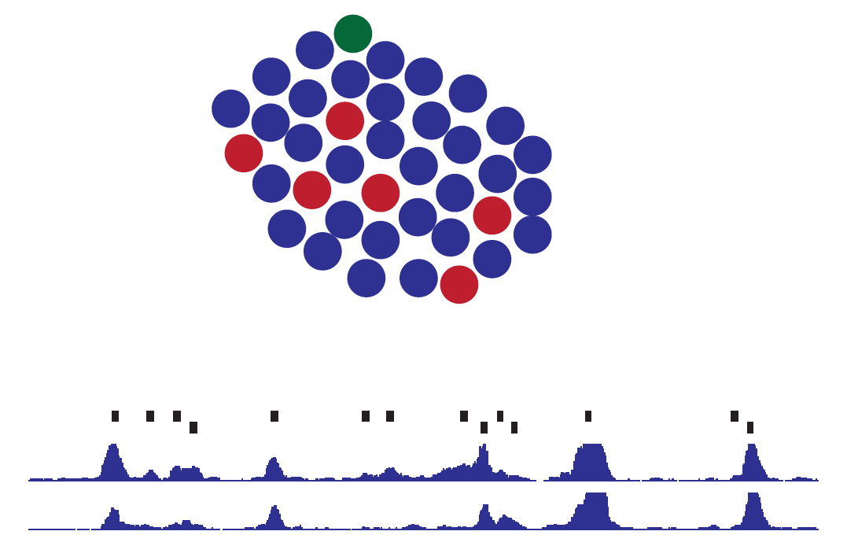
Chromatin accessibility in bulk data might not reflect single cell states

Slide 37
Single cell ATAC-seq
Buenrostro et al., Nature, 2015

Slide 38
Single cell ATAC-seq captures open chromatin in single cells
Buenrostro et al., Nature, 2015

Slide 39
Using ensembles of regions with shared features to overcome sparse coverage
X1
X2
Y3
Y1
Y2
Y3
Schematic depiction of read distribution in single cell ATAC-seq
….

Slide 40
Inference of factors associated with variability between cells
Buenrostro et al., Nature, 2015

Slide 41
Specific TFs are associated with high and low variation
Buenrostro et al., Nature, 2015

Slide 42
Variability in single cell accessibility reveals higher order chromosome organization
Buenrostro et al., Nature, 2015

Slide 43
Combinatorial indexing to boost the number of cells that can be assayed with scATAC-seq
Cusanovich, Science, 2015

Slide 44
scATAC-seq detects co-accessibility between enhancers and promoters
Cusanovich, Science, 2015

Slide 45
Single cell methylome sequencing
Farlik et al, Cell Reports, 2015

Slide 46
Single cell DNA sequencing
Macosko and Carroll, Science, 2013

Slide 47
Numerous applications for single cell sequencing
Wang and Navin, Cell, 2015

Slide 48
Single cell DNA sequencing in tumor cells
Navin et al., Nature, 2011

Slide 49
Single cell ‘multi-omics’
Clark et al., Genome Biology, 2016

Slide 50
Combined single cell methylome and RNA-seq
Angermueller et al., Nature Methods, 2015

Slide 51
What kind of knowledge do we want to obtain?
The Human Cell Atlas- A comprehensive reference map of all cell types and states in the human body
White Paper: http://biorxiv.org/content/early/2017/05/08/121202

